Slide 1
Easypay Global Payroll Solution
Make Your Global Payroll Effortless

Slide 2
Table of Contents
Contents | Pg No. | Contents | Pg No.
Solution Overview | 1 | Views Draft Payroll and its reports. Sends for approval | 9
Payroll Steps Overview | 2 | Approves Draft Payroll by viewing insights | 10
Key Benefits | 3 | Track Payments & Manage Payslips | 11
How to Access Easypay From Oracle? | 4 | Views Advanced Reports and taxes | 12
Views Employee Details in a comprehensive view | 5 | PCL submits reports to agencies | 13
Accesses Deductions & allowances for benefits administration | 6 | Employees view Payslips in Oracle Cloud HCM | 14
Views employees enrolled in different pension schemes | 7
Checks validation report to ensure accuracy | 8
Notes:
Add page no.s
Linking to the right slides ( last )

Slide 3
Solution Overview
PTO Leaves
Allowances and commissions
Bank Details
New Hire and Leavers
Bonuses and many more
Input data into Oracle Cloud HCM
Cloud HCM
Automatic Sync
View Global and country Reports and perform necessary approvals
Global and Regional Payroll Managers
Access payslips and payroll documents via Oracle Cloud HCM
Employees from different countries
1
Notes:
Since we addressed all the challenges lets have an Overview of information flow and the corresponding user journeys in the proposed solution.
From Payroll managers perspective: all the details I have demonstrated in the previous slides are input within Oracle Cloud HCM be it PTO Leaves, Allowances, Bank details, bonuses , new hires or leavers. Everything automatically syncs to Easypay and then all these info is transferred to ADP, RSM via semi automatic tools by PCL. Before moving ahead , I would like to highlight that there are no efforts required from Resolian team in this entire process.
In this whole journey as explained now,
We are utilizing the Oracle Functionalities of storing all this information, hence convivence of entering information just in Oracle Cloud HCM.
No manual addition of information, no double entries, no double check required all resulting in reduction of burden on the payroll team
Also, PCL would be providing advanced personalized global and country level reports as per Resolian requirements
Now moving to payslip and payroll documents transfer functionality, payslips from payroll systems get transferred to Easypay and then synced with Oracle HCM, which .. Emp. Acc → enhances emp experience
Are there any doubts regarding the solution

Slide 4
Taking Personas for explanation
Payroll Steps
Views Employee Details in a comprehensive view
Accesses Deductions & allowances for benefits administration
Views employees enrolled in different pension schemes
Eliminates missing entries and errors detected by AI
Sends payslips to Oracle Cloud HCM at a click of a button
Marks the payroll as paid once PCL does the necessary
Approves Draft Payroll by viewing insights
Views Draft Payroll and its reports. Sends for approval
Christopher Parker
Global Payroll
Manager
Sarah Thomson
Regional Payroll Manager
Reports to Christopher
Views Advanced Reports and taxes
Once approved PCL submits reports to agencies
Employees view Payslips in Oracle Cloud HCM
PCL Admin
Provides support
at all steps
2
Notes:
Analytics at the end → ( management analytics on payroll costs, absences ) + add detailed steps ( to show lot of job is automated ) ➔ seamless
Mention about the services are being offered

Slide 5
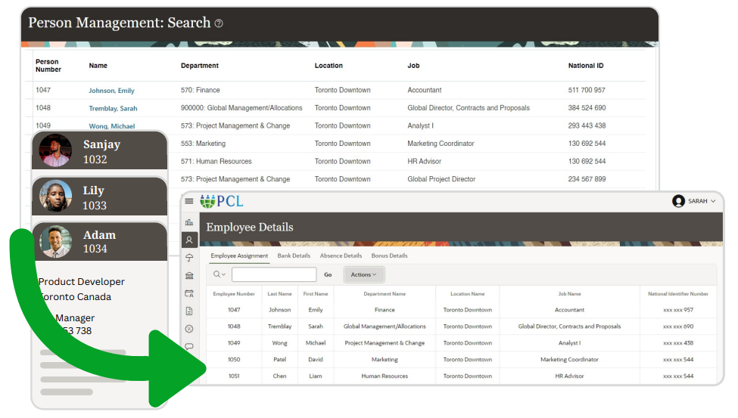
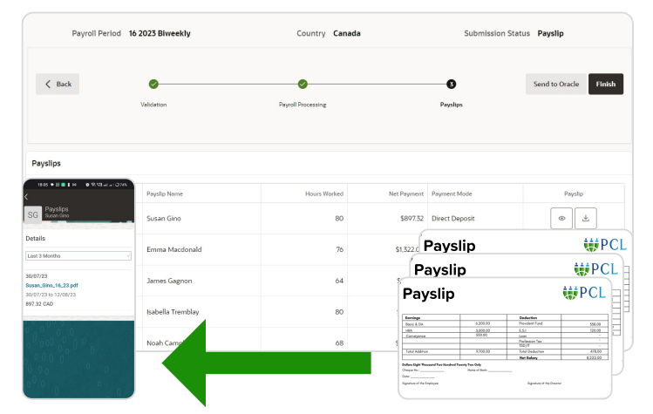
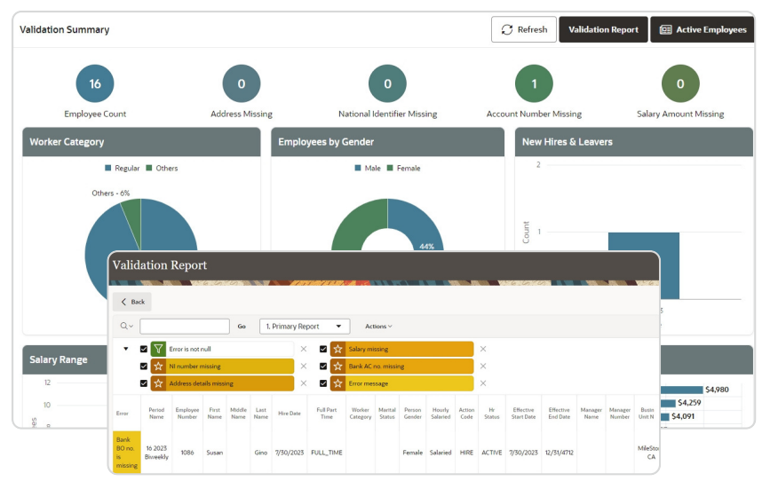
Key Benefits
Real-time Oracle Cloud HCM Sync with Easypay
Pay slips and Payroll documents within Oracle Cloud HCM
Payroll Accuracy backed by Artificial Intelligence
3

Slide 6
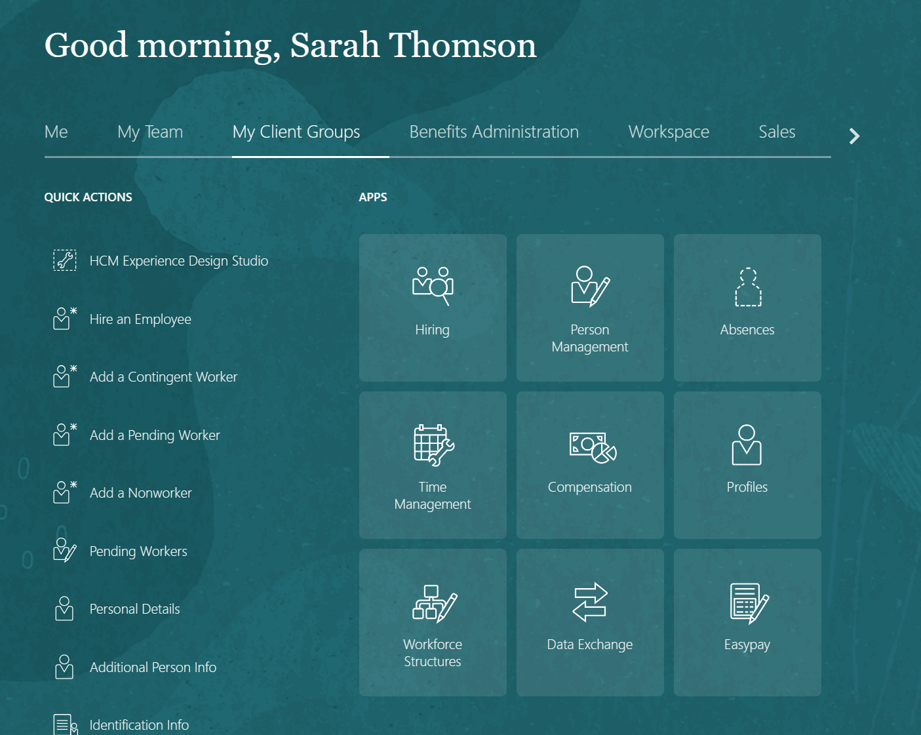
How to Access Easypay From Oracle?
Global and Regional Payroll Managers
Login into my Oracle HCM
My Clients groups
Easypay
4
Notes:
Reset picture > Reflected rounded rectangle >> picture effects > no reflection

Slide 7
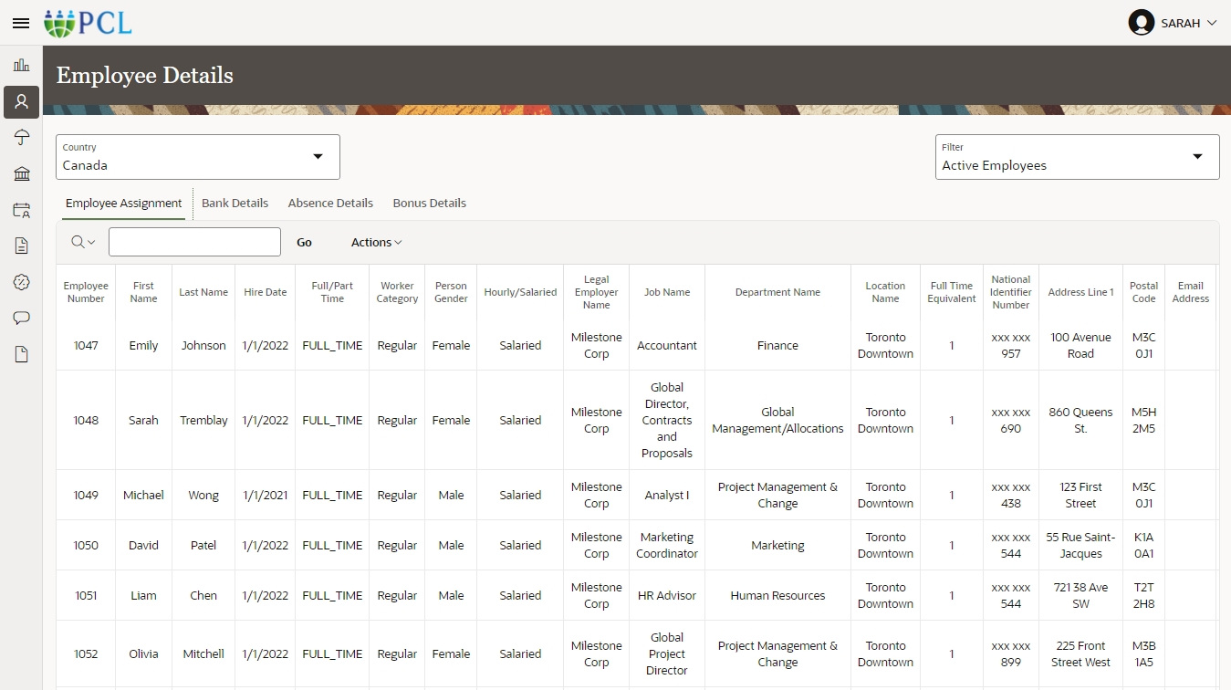
Views Employee Details in a
Comprehensive view
Choose Any Country
Apply Filter like
1.Active Employees
2.All Employees
3.Inactive Employees
View desired details:
PTO Leaves
Allowances
Employee Assignment
Bank Details
Absence Details
Bonus Details
5

Slide 8
Christopher Parker
Payroll Manager
Sarah Thomson
Payroll Admin
PCL ensures compliance and submits reports to agencies
Reports To Christopher
Views Employee Detailes in a comprehensive view
Deductions & allowances for benefits administration
Checks validation report to ensure accuracy
Views Payroll Reports and send for Approvals
Approves Payroll by viewing Insights
Employees view Payslips in Oracle Cloud HCM
Send Payslips to Oracle Cloud HCM
at one click
Views Advanced Reports and taxes

Slide 9
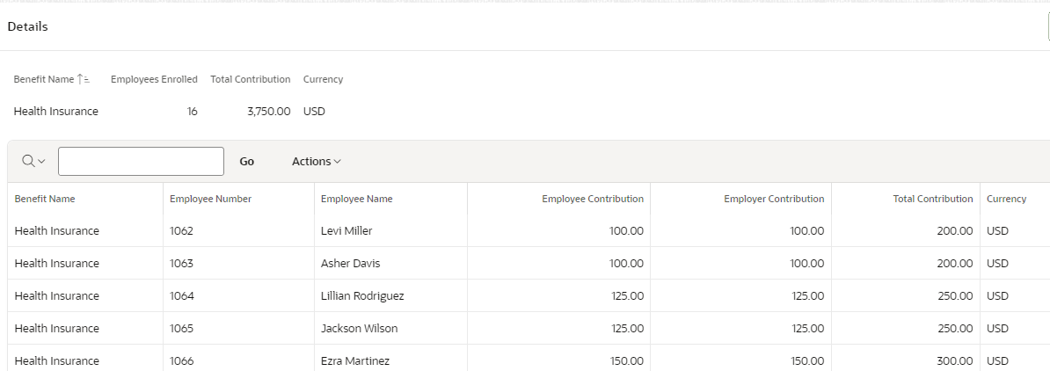
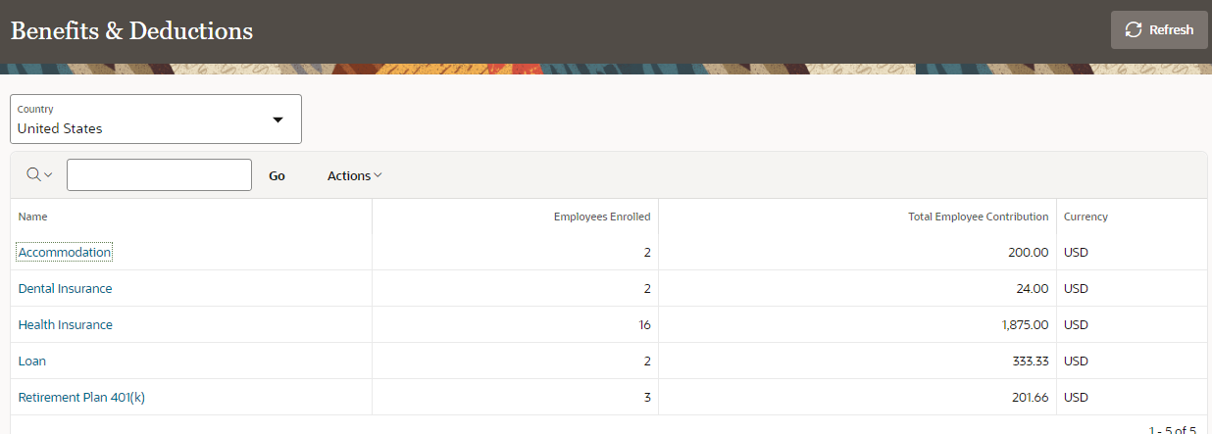
Accesses Deductions and Allowances
for Benefits Administration
Select any Country
Choose any Criteria
Accommodation
Dental Insurance
Health Insurance
Loan
Retirement Plan
6

Slide 10
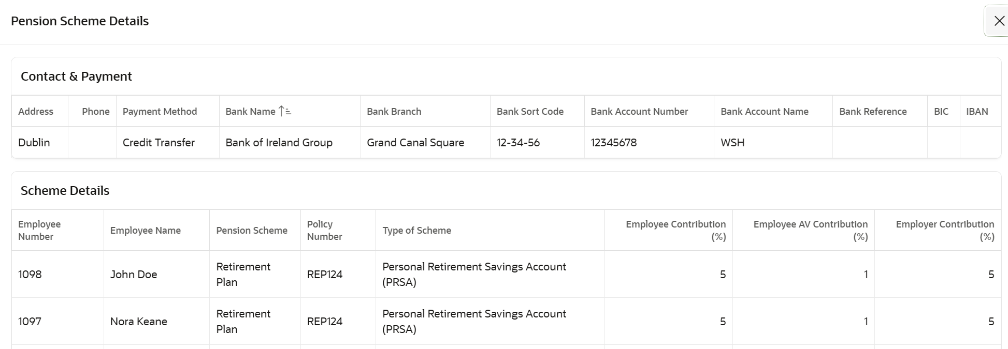
Views employees enrolled in different pension schemes
Select any Country
Views Pension Schemes in Detailed Manner
7

Slide 11
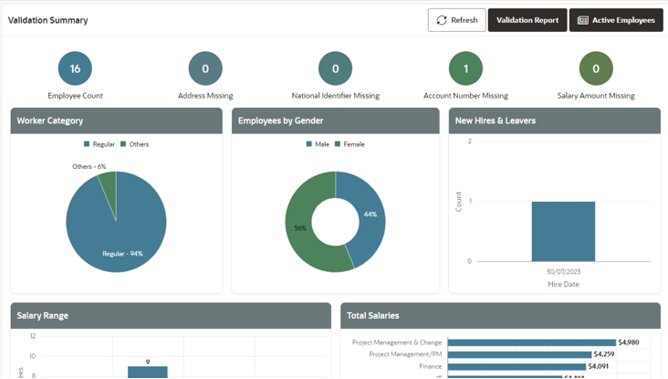
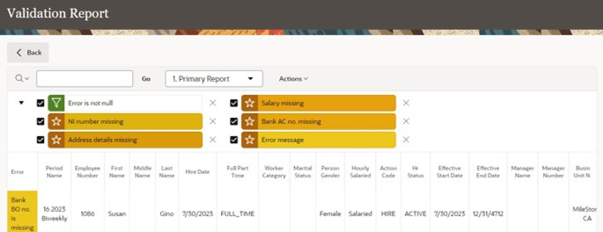
Checks validation report to
ensure Accuracy
Views validation summary
Drill downs into Missing entry
/error by Validation Report
Eliminates Missing entry/error via Oracle Cloud HCM
8

Slide 12
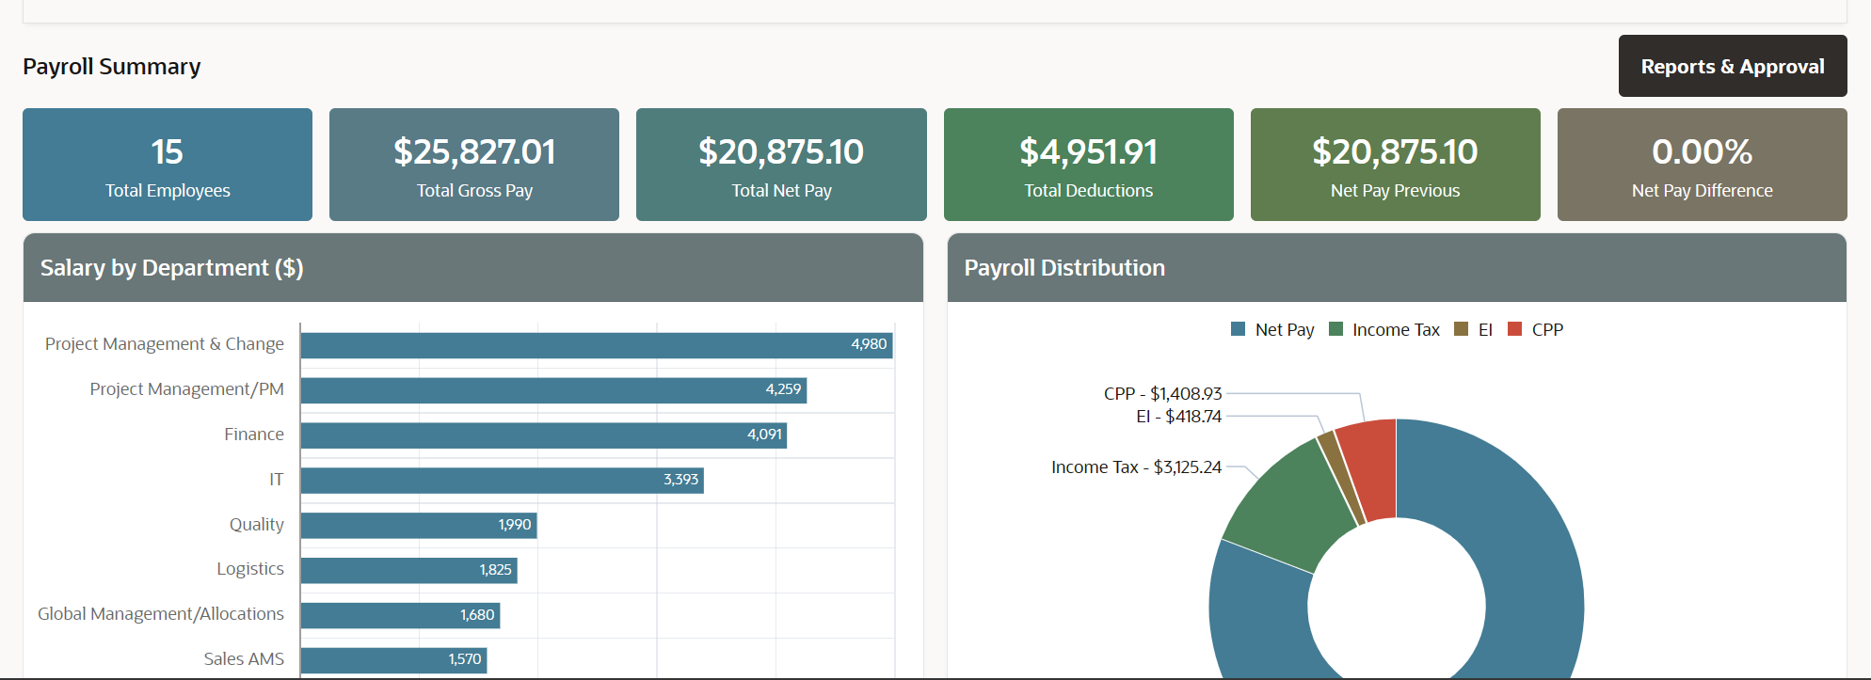
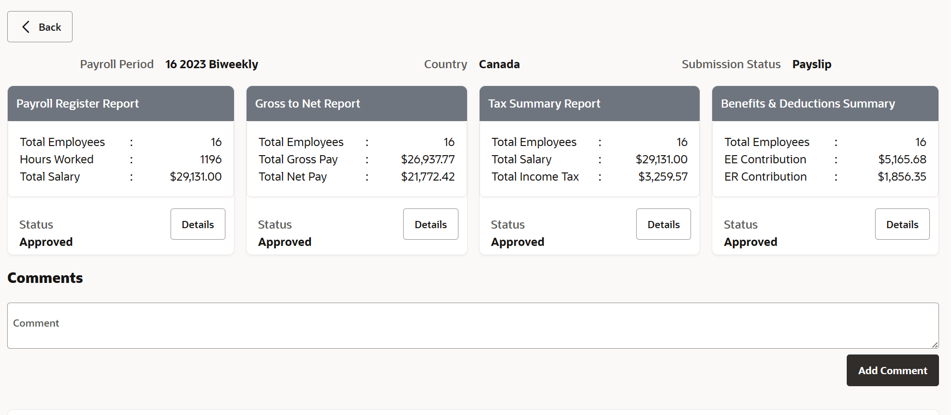
Views Draft Payroll, its reports and sends for approval
Payroll Register Report
Gross to Net Report
Tax Summary Report
Benefits & Deduction Summary
Views Reports of Payroll
Sends For Approval
9

Slide 13
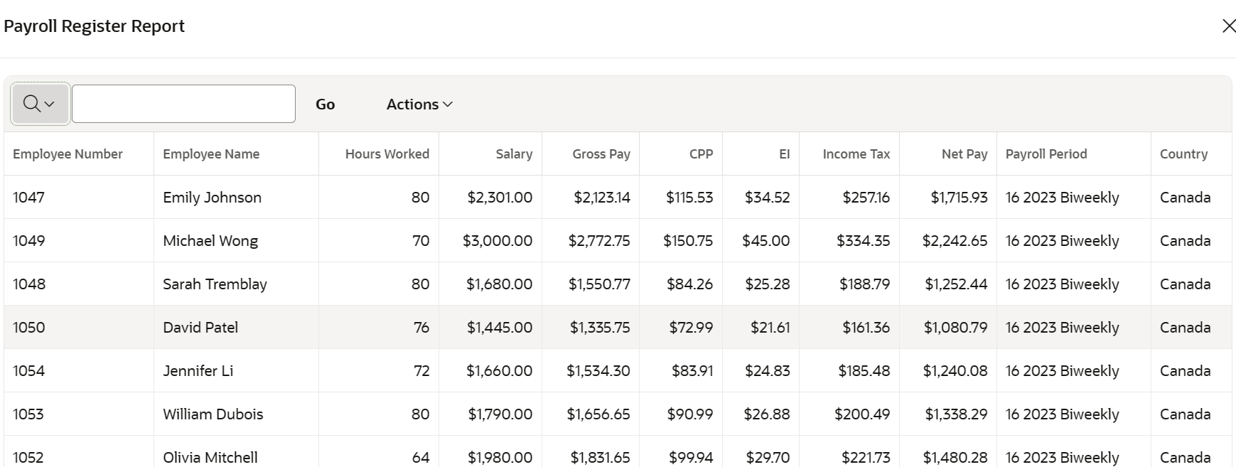
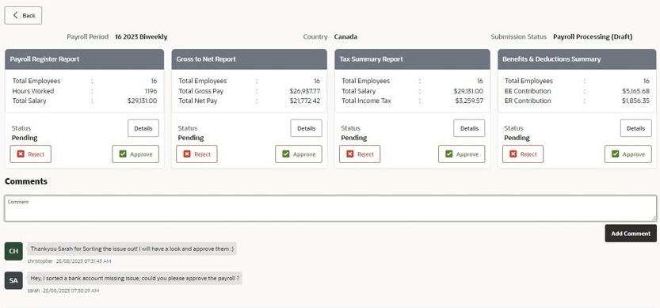
Approves Draft Payroll by
viewing insights
Payroll Register Report
Gross to Net Report
Tax Summary Report
Benefits & Deduction Summary
Views Payroll Reports With Detailed Insights
Approves Reports
Dedicated Comments Section to Communicate
10

Slide 14
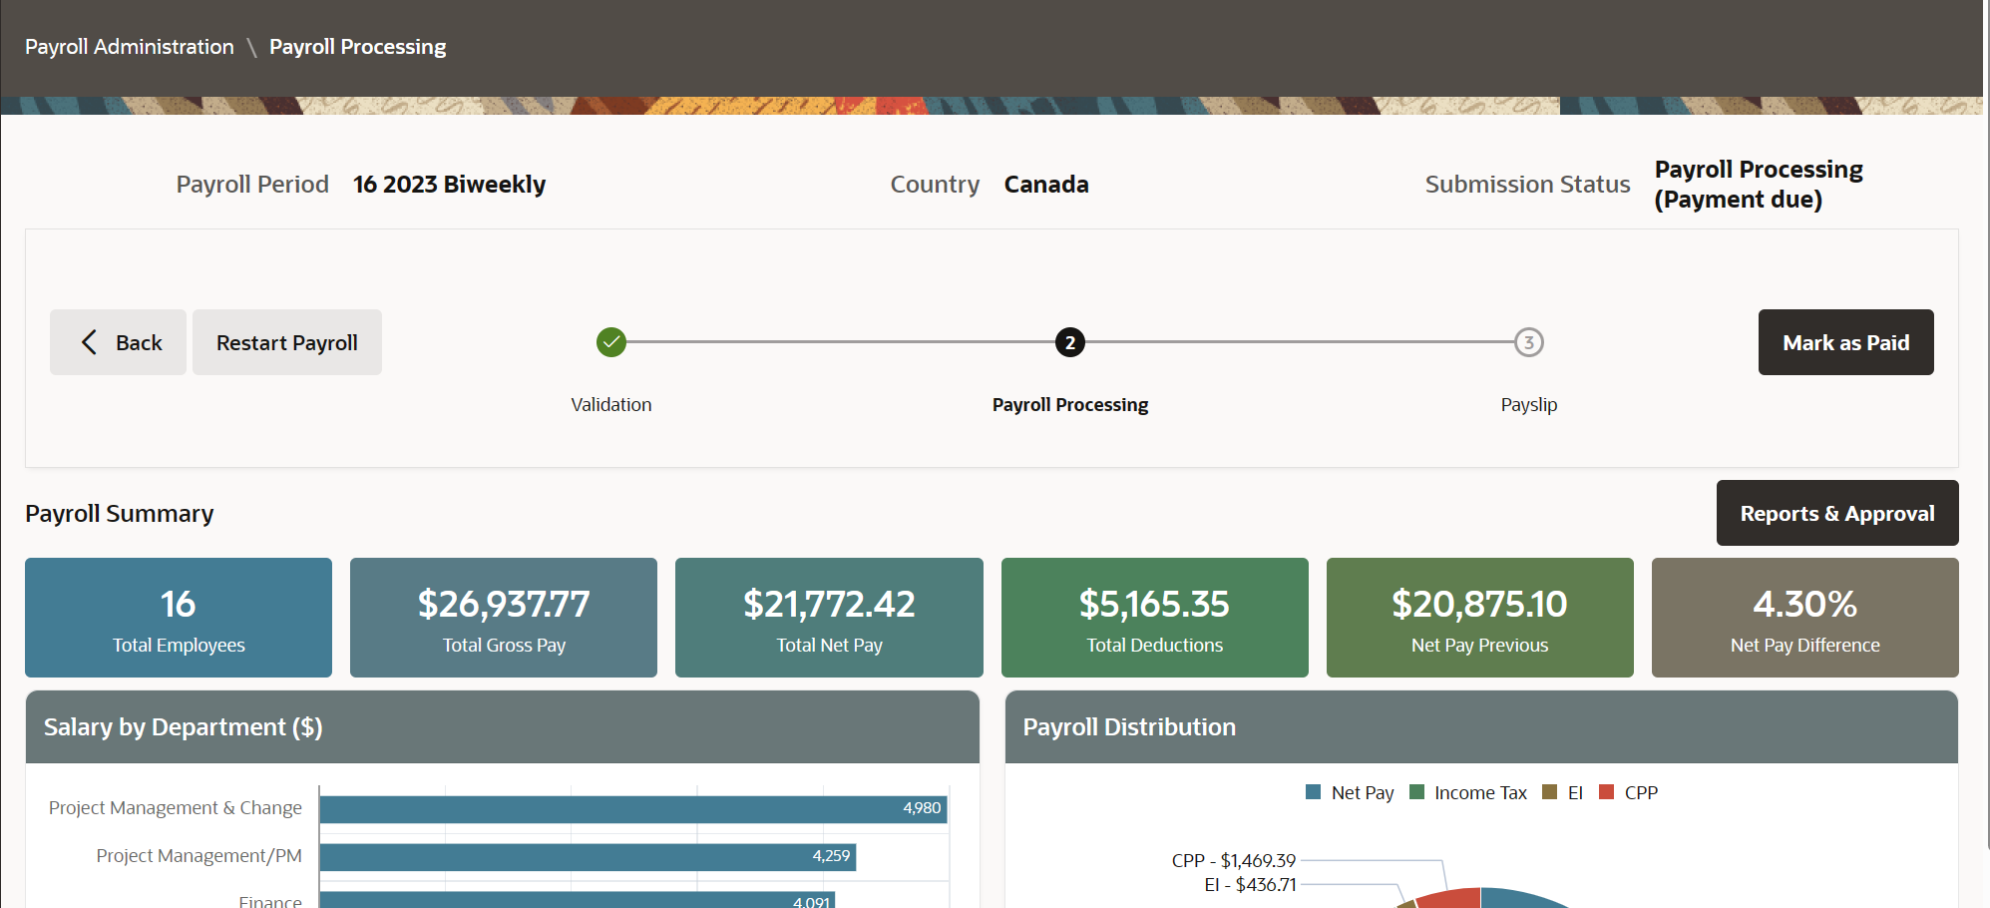
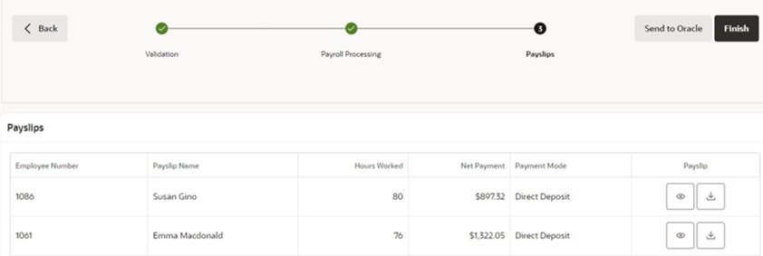
Track Payments & Manage Payslips
Mark Payments as Paid
View Payslips and Send to Oracle
11

Slide 15
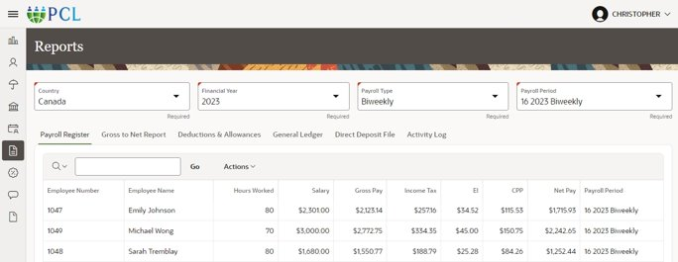
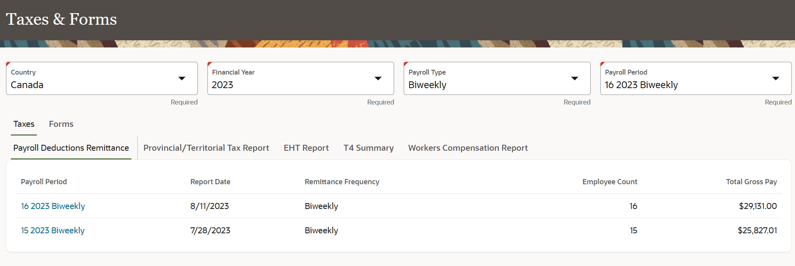
View Advanced Reports and Taxes
Viewing Reports With Detailed Insights
Payroll Register Report
General Ledger
Direct Deposit File
Activity Log etc.
Viewing Taxes and Forms
Payroll Deductions Remittance
EHT Report
T4 Summary
Activity Log etc.
12

Slide 16
PCL submits Compliance Reports/Forms to agencies
Approve all the Reports and Forms
PCL Submits all Reports to Agencies
13

Slide 17
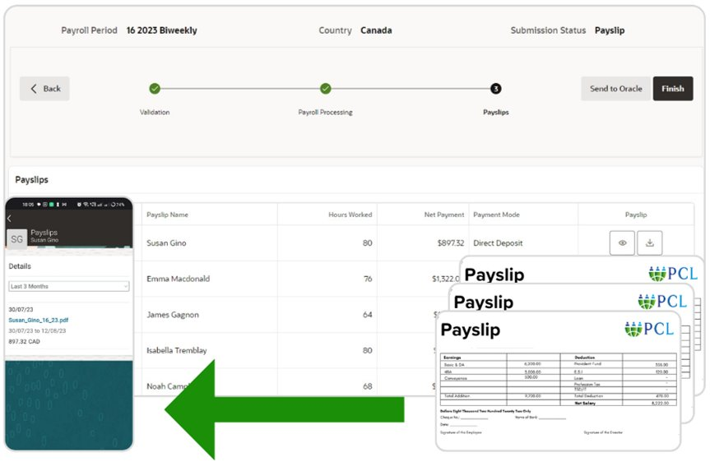
Employees view Payslips in Oracle Cloud HCM
Employees can Easily View Payslips from Me section in Oracle Cloud HCM
Similar way an employee can also view their payroll documents in Oracle itself
14

Slide 18
Unified workforce engagement
Your employees will have a single, self-service user experience for payroll transactions, including access to a range of relevant information, such as payroll activity and payslips
Real-time Data and Global Insights
Provides real-time access to payroll data, and AI-powered Global insights dashboards enabling you to monitor and analyse payroll process
Enhanced Employee Experience
Improves employee satisfaction by providing easy and secure access to payslips and payroll documents
Improved data integrity
The Oracle Cloud HCM and PCL Easypay Global Payroll Solution increases productivity and reduces errors from entering duplicate data, improving the user experience with a more intuitive end-to-end process
Talk to your trusted PCL Consultant today to transform your Global Payroll
contact us at pcl@payrollcloudcorp.com
Visit us at payrollcloudcorp.com
1

